Slide 1

Challenges
Travel mode for customers
Can I buy it today?

Slide 2
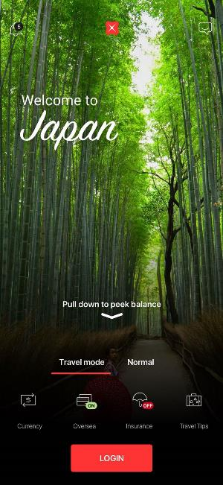
#1
Travel Safe with Travel Mode

Slide 3
MOTIVATION
“Travel Mode” in its mobile banking app– a concept in which customers are given certain features while they travel abroad. The features include the below:
Trigger based on Geolocation
Prompt to Turn On Travel mode and ask for trip type (Business, leisure)
Dynamic App background image change based on location (Opera house if location is Sydney)
Localized Deals & Offers
Localized Exchange Rates
If Travel Mode is ON
Options to purchase Travel Insurance
Purchase Forex on the currency of the travelling country.
Based on historical data, trip type, customer profile (single/married etc) show most relevant deals for the customer.
Travel Safe with Travel Mode

Slide 4
DELIVERABLES
The application should be a mobile based one.
The application should have screens for trivial banking operations like a dashboard to show different Accounts (Default Savings, Foreign currency accounts etc) .
The application should have screens to Turn on/OFF Travel Mode
The application should also provide screens to show various features available for Travel Mode like Purchase Travel Insurance, Display FX Rates updating every 10 seconds, Purchase Forex , Location based Deals & Offers, enable cards for overseas usage for duration of the trip etc
The application should have notification mechanism when it detects customers are out of Singapore (Geolocation based)
Mock the geo location data , Deals and Offers which will be needed by the application to show to the customers.
Based on given historical transactions, recommend deals and offers to the customer.
Travel Safe with Travel Mode
Notes:
\

Slide 5
DELIVERABLES
Explore innovative additional ways to trigger travel mode and demonstrate (e.g. Purchase at Airport/duty free etc, GeoFencing around Immigration).
Based on historical transactions, try to propose an analytical model which can predict the travel mode projection for the bank on monthly basis.
Travel Safe with Travel Mode
Notes:
\

Slide 6
NON-FUNCTIONAL REQUIREMENTS
Scalability
Usability
Fault Tolerance
Availability
Travel Mode

Slide 7
Download datasets below
https://s3-ap-southeast-1.amazonaws.com/h2h-datasets/Challenge2.zip

Slide 8

#2
Can I Buy It Today?

Slide 9
MOTIVATION
Consumers don’t just want lessons about Finance, they want their financial patterns have a more active role by warning and reminding them about important information regarding their own financials. And not only “after the fact” issues. They want to be advised before making bad decisions/actions. For instance, sometimes consumers buy things they cannot afford and can even having them overdrawing their accounts. Other times they can max out their credit cards and have no money to pay back. Those are some of possible scenarios that a better financial planning looking at the past and future could avoid.

Slide 10
Deliverables
To avoid such scenarios build an App that analysis users spend looking at historical transactions, future financial commitments, user’s credit score, and so forth (use your imagination to decide what else data should be helpful to have to answer this question), and upon user question if she/he should buy this particular product/service the app will answer the question taking into consideration all the above.
The application should be a mobile/web or both.
The application should have screen(s) for banking operations like Funds Transfer , Fixed Deposit placement etc and a dashboard to show different Accounts (Savings, credit card etc) .
The application should show remaining monthly expense limit for a transaction on the confirmation page.
Application should have a indicative tracker of monthly expense limit for the customer based on historical data.
Push notifications if customer crosses percentage thresholds of total available monthly expense.

Slide 11
Deliverables
Take into consideration that sometimes the transactions descriptions in the statements are not clear enough and some sort of transaction enhancement is required (e.g. convert the descriptions into readable text that shows each merchant’s name and lists their address and city. It shows the local merchant’s location, so that better inference could be derived.
The application should have a voice front end, where users can just “ask the question: Can I buy it today?”.
Then, the voice interface will reply back: “how much does it cost?”
Then the user reply with the price (using your voice), then the app backend should be able to answer the question.
Application should be able to answer that based on the user profile model derived from computing the data as described before.

Slide 12
NON-FUNCTIONAL REQUIREMENTS
Scalability
Usability
Fault Tolerance
Availability
Performance

Slide 13
Download datasets below
https://s3-ap-southeast-1.amazonaws.com/h2h-datasets/Challenge3.zip

